Slide 1

Algorithm Design and Analysis Chapter 24: Single-Source Shortest Paths
School of Software Shandong University
2023

Slide 3
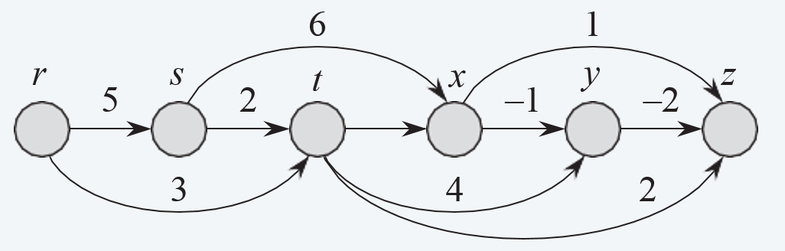
Single-source shortest paths in DAG （Chapter 24.2 in textbook）
Problem. Given a directed acyclic graph G = (V, E), edge lengths we, source s ∈ V, find a shortest directed path from s to every node v∈V.
7

Slide 4
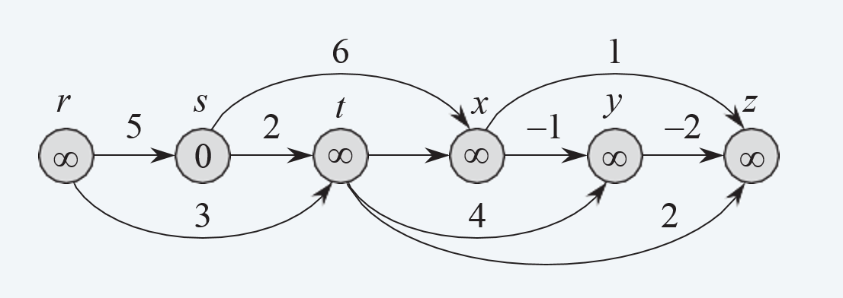
Single-source shortest paths in DAG
r
s
t
x
y
z
7

Slide 5

Single-source shortest paths in DAG
r
s
t
x
y
z
7
2

Slide 6
Single-source shortest paths in DAG
r
s
t
x
y
z
7
2
6

Slide 7
Single-source shortest paths in DAG
r
s
t
x
y
z
7
2
6
5

Slide 8
Single-source shortest paths in DAG
r
s
t
x
y
z
7
2
6
5
3

Slide 9
Single-source shortest paths in DAG
DAG-SHORTEST-PATHS(V, E, w, s)
Topologically sort the vertices of G.
FOREACH node v ∈ V :
M [v] ← ∞.
M [s] ← 0.
FOREACH node v ∈ V , taken in topologically sorted order:
FOREACH edge (u, v) ∈ E :
M [v] ← min { M [v], M [u] + w_{uv} }.
起始点到顶点v的距离

Slide 10
Single-source shortest paths in DAG
r
s
t
x
y
z
7
2
6
5
3
Bottom up
Time complexity: O(m+n)

Slide 11
Single-source shortest paths in DAG
r
s
t
x
z
Bottom up
y
7
Time complexity: O(m+n)
2
6
5
3

Slide 12


Slide 13


Single-source shortest paths problem
Problem. Given a directed graph G = (V, E), edge lengths we ≥ 0, source s ∈ V, find a shortest directed path from s to every node v∈V.
1
15
3
5
4
source s
0
12
3
8
7
7
2
9
9
6
1
11
5
5
4
13
4
20
6
shortest-paths tree

Slide 14

Shortest paths: quiz
Suppose that you change the length of every edge of G as follows. For which is every shortest path in G a shortest path in G′?
Add 17.
Multiply by 17.
Either A or B.
Neither A nor B.
24
7
s —1 —2 3— t
18 19 20

Slide 15

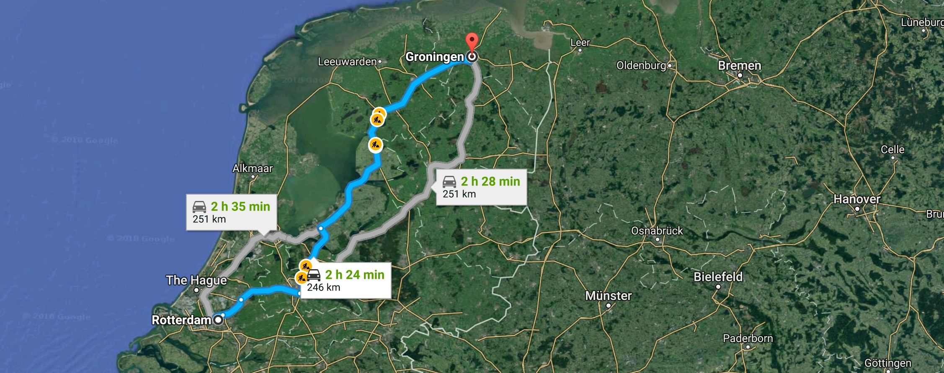
Edsger Dijkstra
“ What’s the shortest way to travel from Rotterdam to Groningen?
It is the algorithm for the shortest path, which I designed in about 20 minutes. One morning I was shopping in Amsterdam with my young fiancée, and tired, we sat down on the café terrace to drink a cup of coffee and I was just thinking about whether I could do this, and I then designed the algorithm for the shortest path. ” — Edsger Dijsktra

Slide 16
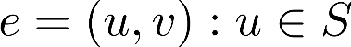
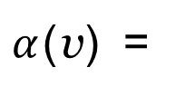
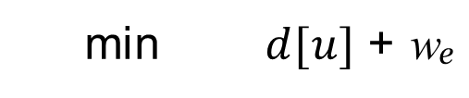
Dijkstra′s algorithm (for single-source shortest paths problem)
Greedy approach. Maintain a set of explored nodes S for which algorithm has determined d[u] = final length of a shortest s↝u path.
Initialize S ← { s }, d[s] ← 0.
Repeatedly: choose unexplored node v ∉ S which minimizes
$α$(v) =
min $d[u]$ + w_{e}
add v to S, and set d[v] ← $α$(v).
the length of a shortest path from s to some node u in S, followed by an edge e = (u, v)
d[u]
u
w_{e}
v
S
s

Slide 17
Dijkstra′s algorithm (for single-source shortest paths problem)
Greedy approach. Maintain a set of explored nodes S for which algorithm has determined d[u] = final length of a shortest s↝u path.
Initialize S ← { s }, d[s] ← 0.
Repeatedly: choose unexplored node v ∉ S which minimizes
$α$(v) =
min $d[u]$ + w_{e}
add v to S, and set d[v] ← $α$(v).
To recover path, set π[v] ← u that achieves min.
d[v]
v
d[u]
u
w_{e}
S
s

Slide 18


Dijkstra’s algorithm demo
Initialization.
・For all v ≠ s : α[v] ← ∞.
・For all v ≠ s : π[v] ← null.
・S ← ∅ and α[s] ← 0.
α[s]
←
0
s
16
2
4
8
7
5
6
3
1

Slide 19
Dijkstra’s algorithm demo
Basic step. Choose unexplored node u ∉ S with minimum α[u].
・Add u to S.
・For each edge e = (u, v) leaving u, if α[v] > α[u] + we
- α[v] ← α[u] + we
then:
- π[v] ← u
0
0 + 16 = 16
s
16
4
8
0 + 4 = 4
0 + 8 = 8

Slide 20
Dijkstra’s algorithm demo
Basic step. Choose unexplored node u ∉ S with minimum α[u].
・Add u to S.
・For each edge e = (u, v) leaving u, if α[v] > α[u] + we
- α[v] ← α[u] + we
then:
- π[v] ← u
0
0 + 16 = 16
s
16
4
8
v
0 + 4 = 4
0 + 8 = 8

Slide 21
Dijkstra’s algorithm demo
Basic step. Choose unexplored node u ∉ S with minimum α[u].
・Add u to S.
・For each edge e = (u, v) leaving u, if α[v] > α[u] + we
- α[v] ← α[u] + we
then:
- π[v] ← u
0
16
s
3
4
8
4 + 3 = 7

Slide 22
Dijkstra’s algorithm demo
Basic step. Choose unexplored node u ∉ S with minimum α[u].
・Add u to S.
・For each edge e = (u, v) leaving u, if α[v] > α[u] + we
- α[v] ← α[u] + we
then:
- π[v] ← u
0
16
s
3
4
8
4 + 3 = 7

Slide 23
Dijkstra’s algorithm demo
Basic step. Choose unexplored node u ∉ S with minimum α[u].
・Add u to S.
・For each edge e = (u, v) leaving u, if α[v] > α[u] + we
- α[v] ← α[u] + we
then:
- π[v] ← u
7 + 7 = 14
16
0
s
7
1
4
7
7 + 1 = 8

Slide 24
Dijkstra’s algorithm demo
Basic step. Choose unexplored node u ∉ S with minimum α[u].
・Add u to S.
・For each edge e = (u, v) leaving u, if α[v] > α[u] + we
- α[v] ← α[u] + we
then:
- π[v] ← u
7 + 7 = 14
16
0
s
7
1
4
7
7 + 1 = 8

Slide 25
Dijkstra’s algorithm demo
Basic step. Choose unexplored node u ∉ S with minimum α[u].
・Add u to S.
・For each edge e = (u, v) leaving u, if α[v] > α[u] + we
- α[v] ← α[u] + we
then:
- π[v] ← u
8 + 5 = 13
14
0
8 + 6 = 14
s
5
6
4
7
8

Slide 26
Dijkstra’s algorithm demo
Basic step. Choose unexplored node u ∉ S with minimum α[u].
・Add u to S.
・For each edge e = (u, v) leaving u, if α[v] > α[u] + we
- α[v] ← α[u] + we
then:
- π[v] ← u
8 + 5 = 13
14
0
8 + 6 = 14
s
5
6
4
7
8

Slide 27
Dijkstra’s algorithm demo
Basic step. Choose unexplored node u ∉ S with minimum α[u].
・Add u to S.
・For each edge e = (u, v) leaving u, if α[v] > α[u] + we
- α[v] ← α[u] + we
then:
- π[v] ← u
13 + 2 = 15
14
0
13
s
2
4
7
8

Slide 28
Dijkstra’s algorithm demo
Basic step. Choose unexplored node u ∉ S with minimum α[u].
・Add u to S.
・For each edge e = (u, v) leaving u, if α[v] > α[u] + we
- α[v] ← α[u] + we
then:
- π[v] ← u
0
13
14
s
4
7
8

Slide 29
Dijkstra’s algorithm demo
Basic step. Choose unexplored node u ∉ S with minimum α[u].
・Add u to S.
・For each edge e = (u, v) leaving u, if α[v] > α[u] + we
- α[v] ← α[u] + we
then:
- π[v] ← u
0
13
14
s
4
7
8

Slide 30
Dijkstra’s algorithm demo
Termination.
・ α[v] = length of a shortest s↝v path.
・π[v] = the precedence of v on a shortest s↝v path.
0
13
14
s
v
4
7
8

Slide 31
Dijkstra’s algorithm: implementation
For each unexplored node v ∉ S :
α(v) can only decrease (because set S increases).
More specifically, suppose u is added to S and there is an edge e = (u, v)
leaving u. Then, it suffices to update:
α[v] ← min { α[v], α[u] + w e }
recall: for each u ∈ S,
α[u] = d [u] = length of shortest s↝u path
Use a min-oriented priority queue (PQ) to choose an unexplored node v that minimizes α[v].

Slide 32
Dijkstra’s algorithm: implementation
Implementation.
Algorithm maintains α [v] for each node v.
Priority queue PQ stores unexplored nodes, using α [⋅] as priorities.
Once u is deleted from PQ, α [u] = length of a shortest s↝u path.
DIJKSTRA (V, E, w, s)
FOREACH v ≠ s : α [v] ← ∞, π[v] ← null , α [s] ← 0. Create an empty priority queue PQ.
FOREACH v ∈ V : INSERT(PQ, v, α [v]). WHILE (IS-NOT-EMPTY(PQ))
u ← EXTRACT-MIN(PQ). // put u into S
FOREACH edge e = (u, v) leaving u:
IF (α [v] > α [u] + we)
DECREASE-KEY(PQ, v, α [u] + w e ).
α [v] ← α [u] + w e ;
π[v] ← u.

Slide 33
Dijkstra’s algorithm: which priority queue?
Performance. Depends on PQ: n INSERT, n EXTRACT-MIN, ≤ m DECREASE-KEY.
Array implementation optimal for dense graphs.
Θ(n²) edges
Binary heap much faster for sparse graphs.
Θ(n) edges
4-way heap worth the trouble in performance-critical situations.
priority queue | INSERT | DELETE-MIN | DECREASE-KEY | total
unordered array | O(1) | O(n) | O(1) | O(n²)
binary heap | O(log n) | O(log n) | O(log n) | O(m log n)
d-way heap (Johnson 1975) | O(d logd n) | O(d logd n) | O(logd n) | O(m logm/n n)
Fibonacci heap (Fredman–Tarjan 1984) | O(1) | O(log n) † | O(1) † | O(m + n log n)
integer priority queue (Thorup 2004) | O(1) | O(log log n) | O(1) | O(m + n log log n)
† amortized

Slide 34
Dijkstra’s algorithm: proof of correctness
Invariant. For each node u ∈ S : d[u] = final length of a shortest s↝u path.
Pf. [ by induction on |S| ]
Base case: |S| = 1 is easy since S = {s} and d[s] = 0.
Inductive hypothesis: Assume true for |S| ≥ 1.
Let v be next node added to S, and let (u, v) be the final edge.
A shortest s↝u path plus (u, v) is an s↝v path of length α(v).
Consider any other s↝v path P. We show that it is no shorter than α(v).
Let e = (x, y) be the first edge in P that leaves S,
and let P' be the subpath from s to x.
P'
e
y
x
The length of P is already ≥ α(v) as soon
as it reaches y:
P
s
S
u
v
non-negative lengths
inductive hypothesis
definition of α(y)
Dijkstra choses v
instead of y

Slide 35
Shortest paths: quiz
How to solve the the single-source shortest paths problem in undirected graphs with positive edge lengths?
Replace each undirected edge with two antiparallel edges of same length. Run Dijkstra’s algorithm in the resulting digraph.
Modify Dijkstra’s algorithms so that when it processes node u, it consider all edges incident to u (instead of edges leaving u).
Either A or B.
Neither A nor B.

Slide 37



Shortest paths with negative weights （Chapter 24.1 in textbook）
Single-source shortest-paths problem. Given a digraph G = (V, E) with arbitrary edge lengths l_{uv} and a source node s, find a shortest s↝v path to every node v in V .
1
2
4
5
2
—3
5
5
2
s
shortest-paths

Slide 38


Shortest paths with negative weights: failed attempts
Dijkstra. May not produce shortest paths when edge lengths are negative.
s
6
v
2
4
—8
Dijkstra selects the nodes in the order s, t, w, v
But shortest path from s to t is s→v→w→t.
t
3
w
Reweighting ? Adding a constant to every edge length does not necessarily make Dijkstra’s algorithm produce shortest paths.
s
14
v
Adding 8 to each edge weight changes the shortest path from s→v→w→t to s→t.
10
12
0
t
11
w

Slide 39

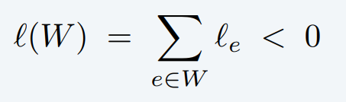
Negative cycles
Def. A negative cycle is a directed cycle for which the sum of its edge lengths is negative.
5
—3
—3
4
—4
a negative cycle W :

Slide 40
Shortest paths and negative cycles
Lemma 1. If some s↝v path contains a negative cycle, then there does not exist a shortest s↝v path.
Pf. If there exists such a cycle W, then can build a s↝v path of arbitrarily negative length by detouring around W as many times as desired. ▪
s
v
W
l(W) < 0

Slide 41
Shortest paths and negative cycles
Lemma 2. If G has no negative cycles, then there exists a shortest s↝v path that is simple (and has at most n – 1 edges).
Pf.
Among all shortest s↝v paths, consider one that uses the fewest edges.
If that path P contains a directed cycle W, can remove the portion of P
corresponding to W without increasing its length. ▪
s
v
W
l(W) ≥ 0

Slide 42


Shortest paths and negative cycles
Single-source shortest-paths problem. Given a digraph G = (V, E) with edge lengths l_{uv} (but no negative cycles) and a source node s, find a shortest s↝v path to every node v.
Negative-cycle problem. Given a digraph G = (V, E) with edge lengths l_{uv}, find a negative cycle (if one exists).
1
2
5
4
5
2
—3
5
—3
—3
5
2
s
4
—4
shortest-paths tree
negative cycle

Slide 43
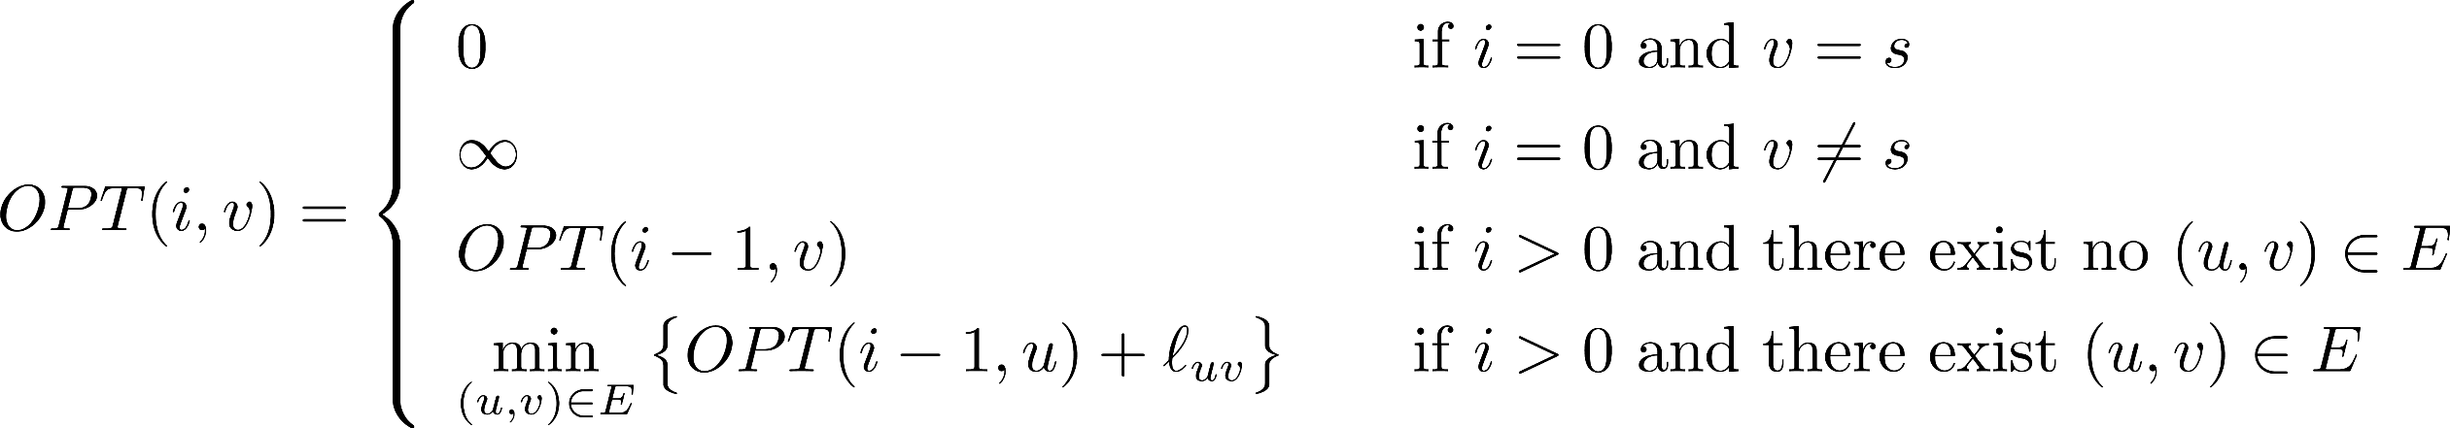
Shortest paths without negative cycles: dynamic programming
Def. OPT(i, v) = length of shortest s↝v path that uses at most i edges.
Goal.
OPT(n – 1, v) for each v.
by Lemma 2, if no negative cycles, there exists a shortest s↝v path that is simple.
Bellman equation.

Slide 44
Shortest paths without negative cycles: algorithm pseudo-code
SHORTEST-PATHS(V, E, l, s)
FOREACH node v ∈ V :
M [0, v] ← ∞.
M [0, s] ← 0.
FOR i = 1 TO n – 1
FOREACH node v ∈ V :
M [i, v] ← M [i – 1, v].
FOREACH edge (u, v) ∈ E :
M [i, v] ← min { M [i, v], M [i – 1, u] + l_{uv} }.
Bellman equation:

Slide 45
Shortest paths without negative cycles: analysis
Theorem 1. Given a digraph G = (V, E) with no negative cycles, the DP algorithm computes the length of a shortest s↝v path for every node v in Θ(mn) time and Θ(n²) space.
Proof.
Table requires Θ(n²) space.
Each iteration i takes Θ(m) time since we examine each edge once. ▪
SHORTEST-PATHS(V, E, l, s)
FOREACH node v ∈ V :
M [0, v] ← ∞.
M [0, s] ← 0.
FOR i = 1 TO n – 1
FOREACH node v ∈ V :
M [i, v] ← M [i – 1, v].
FOREACH edge (u, v) ∈ E :
M [i, v] ← min { M [i, v], M [i – 1, u] + l_{uv} }.
pass i O(m) time

Slide 46

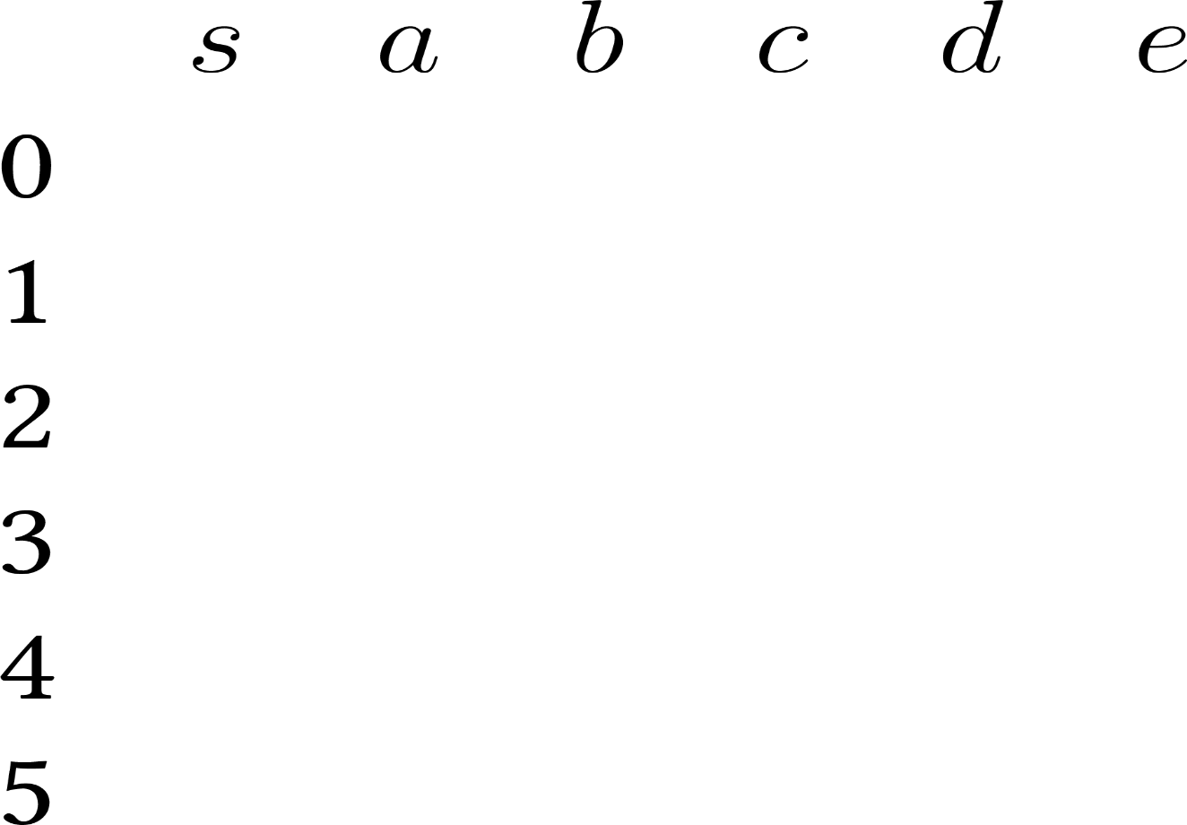

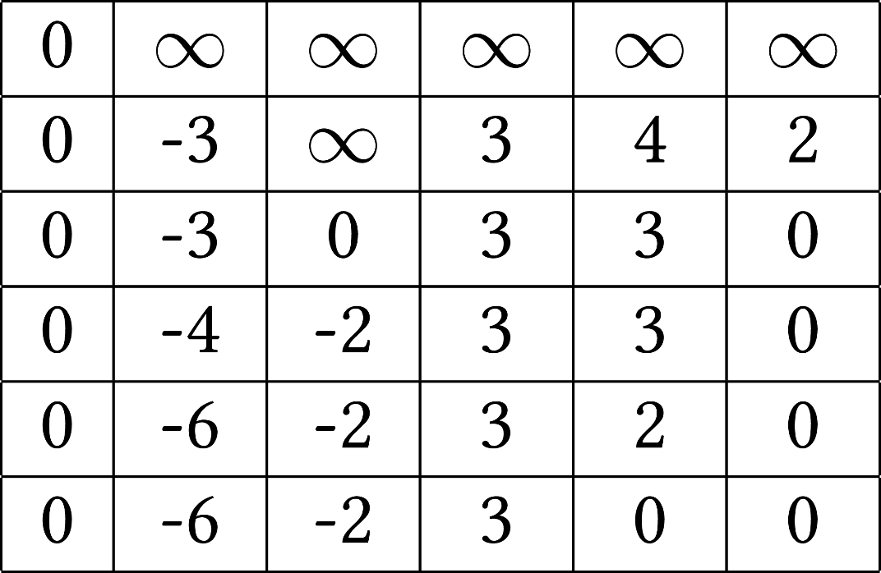

Shortest paths without negative cycles: example
a
–3
6
–4
d
–1
4
b
s
–2
8
e
2
–3
c
3

Slide 47
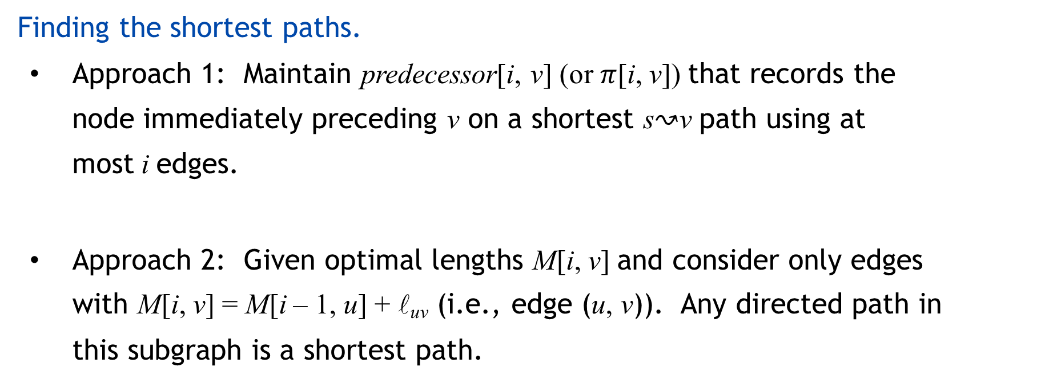
Shortest paths without negative cycles
Finding the shortest paths.
Approach 1: Maintain predecessor[i, v] (or $π$[i, v]) that records the node immediately preceding v on a shortest s↝v path using at most i edges.
Approach 2: Given optimal lengths M[i, v] and consider only edges with M[i, v] = M[i – 1, u] + l_{uv} (i.e., edge (u, v)). Any directed path in this subgraph is a shortest path.

Slide 48
Shortest paths without negative cycles: practical improvements
Space optimization. Maintain a 1D arrays (instead of 2D array).
d[v] = length of a shortest s↝v path that we have found so far.
BELLMAN–FORD(V, E, l, s)
FOREACH node v ∈ V :
d[v] ← ∞.
d[s] ← 0.
FOR i = 1 TO n – 1
FOREACH node v ∈ V :
FOREACH edge (u, v) ∈ E :
IF (d[v] > d[u] + l_{uv})
d[v] ← d[u] + l_{uv}.
pass i O(m) time

Slide 49
Bellman–Ford: correctness analysis
Lemma 3. For each node v, d[v] is monotone non-increasing.
Lemma 4. After pass i, d[v] ≤ length of any s↝v path using at most i edges.
Proof. [ by induction on i ]
Base case: i = 0.
Assume true after pass i -1.
Let P be any s↝v path with at most i edges.
Let (u, v) be the last edge in P and let P' be subpath from s to u.
By inductive hypothesis, at the end of pass i -1, since P' is a s↝u path with at most i -1 edges, we have d[u] ≤ l(P') .
After considering edge (u, v) in pass i :
d[v] ≤
d[u] + l_{uv}
≤ l(P') + l_{uv}
= l(P) ▪
Remark. If shortest path really has k edges, then algorithm finds it after at most k passes.

Slide 50
Bellman–Ford: analysis
Theorem 2. Assuming no negative cycles, Bellman–Ford computes the lengths of the shortest s↝v paths in O(mn) time and Θ(n) extra space.
Pf. Lemma 2 + Lemma 4. ▪
shortest path exists and has at most n−1 edges
after i passes,
d[v] ≤ length of shortest path that uses at most i edges

Slide 51

Single-source shortest paths with negative weights
Single-source Shortest Paths with Weights Between – W and W
year | worst case | discovered by
1955 | O(n⁴) | Shimbel
1956 | O(m n² W) | Ford
1958 | O(m n) | Bellman, Moore
1983 | O(n^{3/4} m log W) | Gabow
1989 | O(m n^{1/2} log(nW)) | Gabow–Tarjan
1993 | O(m n^{1/2} log W) | Goldberg
2005 | O(n^{2.38} W) | Sankowsi, Yuster–Zwick
2016 | Õ(n^{10/7} log W) | Cohen–Mądry–Sankowski–Vladu
20xx

Slide 52


Detecting negative cycles
Negative cycle detection problem. Given a digraph G = (V, E), with edge lengths l_{uv}, find a negative cycle (if one exists).
5
6
—3
2
4
—3
—3
4
—4

Slide 53
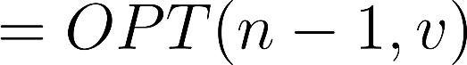
Detecting negative cycles
Lemma 5. If OPT(n, v) = OPT(n – 1, v) for every node v, then no negative cycles.
Pf. For every node v, if OPT(n, v) = OPT(n – 1, v), then
.
Similarly,
.
In fact, for any n' > n, we have .
In other words, OPT(n, v) values have converged ⇒ shortest s↝v path exists. According to Lemma 1, there exists no negative cycle. ▪

Slide 54
Detecting negative cycles
Lemma 6. If OPT(n, v) < OPT(n – 1, v) for some node v, then (any) shortest s↝v
path of length at most n contains a cycle W. Moreover W is a negative cycle.
Pf. [by contradiction]
Since OPT(n, v) < OPT(n – 1, v), any shortest s↝v path P of length at most n in fact has exactly n edges. Otherwise, OPT(n, v) = OPT(n – 1, v).
a contradiction
By pigeonhole principle, the path P must contain a repeated node x.
Let W be any cycle in P.
If W is not a negative cycle, then deleting W yields a s↝v path with at most n – 1 edges and no greater weight. I.e., OPT(n, v) ≥ OPT(n – 1, v) .
⇒ W is a negative cycle. ▪
x
s
v
W
c(W) < 0
Lemma 6’. If no negative cycles, then OPT(n, v) = OPT(n – 1, v) for every node v.

Slide 55
Detecting negative cycles
Theorem 4. OPT(n, v) = OPT(n – 1, v) for every node v, if and only if no negative cycles.
Pf. Lemma 5 + Lemma 6’. ▪
Theorem 5. Can find a negative cycle in Θ(mn) time.
Pf.
Case 1. [ OPT(n, v) = OPT(n – 1, v) for every node v ]
Case 2. [ OPT(n, v) < OPT(n – 1, v) for some node v ]
By Lemma 5, no negative cycles.
By Lemma 6, can extract negative cycle from s ↝ v path. ▪
5
6
—3
2
4
—3
—3
4
—4

Slide 56
Detecting negative cycles
BELLMAN–FORD(V, E, l, s)
FOREACH node v ∈ V :
d[v] ← ∞.
predecessor[v] ←null.
d[s] ← 0.
FOR i = 1 TO n – 1
FOREACH node v ∈ V :
FOREACH edge (u, v) ∈ E :
IF (d[v] > d[u] + l_{uv})
d[v] ← d[u] + l_{uv}.
predecessor[v] ← u.
pass i O(m) time
FOREACH edge (u, v) ∈ E :
IF (d[v] > d[u] + l_{uv})
RETURN TRUE.
RETURN FALSE.

Slide 57


